Slide 1

Mobile ad hoc networks (MANET)
Department of CSE, IUT

Slide 2
What is manet?
Mobile Ad Hoc Network (MANET) is –
collection of wireless mobile nodes
having multi-hop connections
without centralized control
without established infrastructure
Highly error prone and failure prone due to –
mobility of nodes
high interference
lack of infrastructure

Slide 3
what is manet?
wireless networks can be classified into Infrastructured and Infrastructureless
in Infrastructured wireless networks
mobile node can move while communicating
the base station is fixed
if mobile node moves out of range, it gets into the range of another station
in Infrastructureless or Ad Hoc wireless networks
there are no fixed base stations
all the nodes in the network act as routers
nodes can dynamically establish routing to form network ‘on the fly’

Slide 4
what is manet?
Application scenarios include (but not limited to) the following:
Tactical Networks:
Military communication and operations
Automated Battlefields
Emergency services
Search and rescue operations
Disaster Recovery
Policing and Fire Fighting
Supporting doctors and nurses in hospitals

Slide 5
what is manet?
Home and Enterprise networks
Home/office wireless networking
Conferences and meeting rooms
Personal Area Networks (PAN)
Entertainment
Multi-user games
Outdoor Internet Access
Sensor networks
Commercial and civilian environments

Slide 6
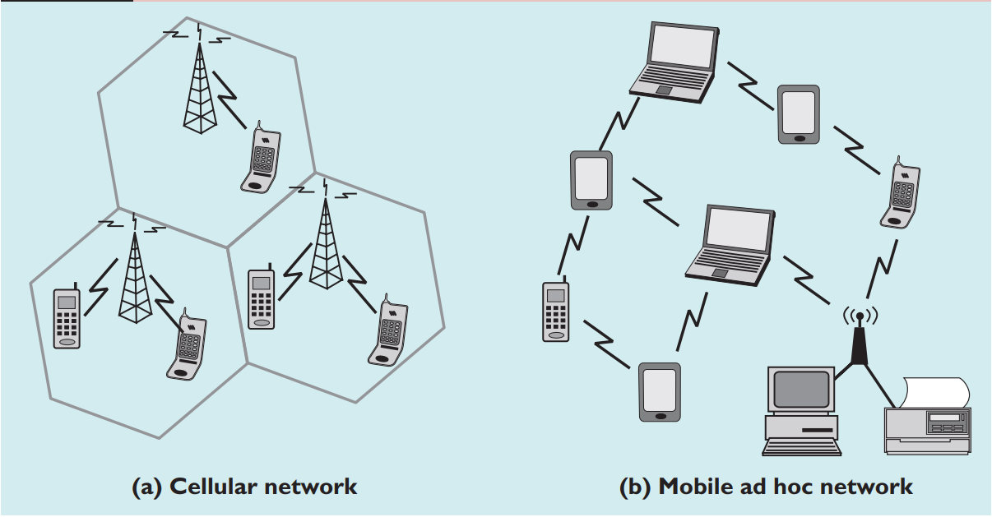
Cellular networks versus mobile ad hoc networks

Slide 7
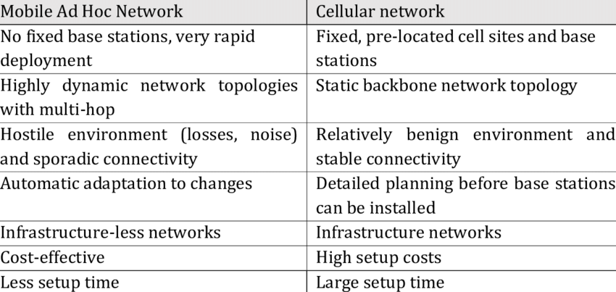
Cellular networks versus mobile ad hoc networks

Slide 8
manet documentation
MANET covers a very broad range of networks
The protocols are ever-changing and constantly being updated
Internet Engineering Task Force (IETF) creates the standards and documentations for different MANET technologies
https://datatracker.ietf.org/wg/manet/about/

